Slide 1


Turn Any Document into a Chatbot: RAG with LangChain
Live Webinar - Learn with Sarvesh
9th Nov 2025

Slide 2

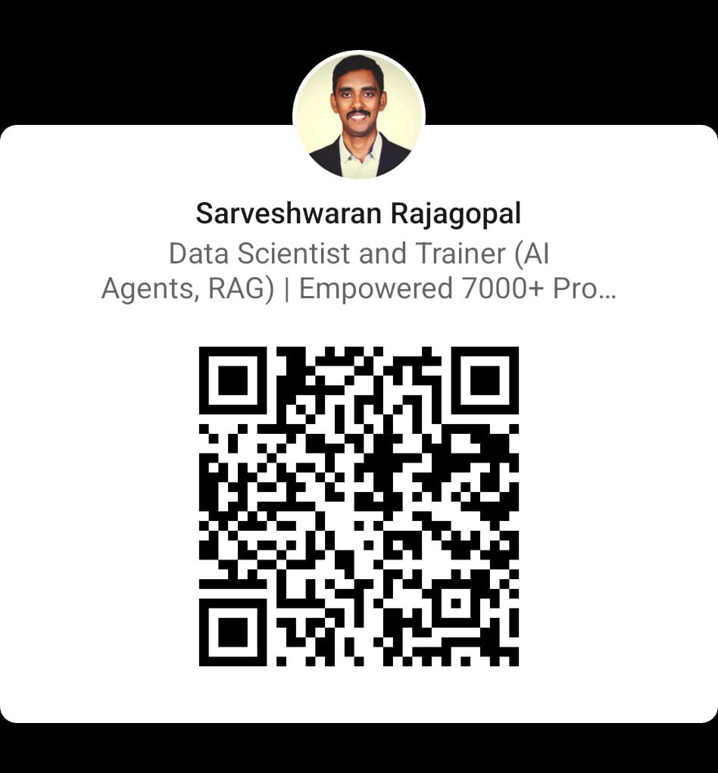

My profile
Sarveshwaran Rajagopal Data Scientist & Trainer (AI Agents, RAG) | Founder – Learn with Sarvesh Empowered 7000+ professionals & students in Data Science & AI

Slide 3


Today’s goal
Make that system conversational

Slide 4
What is RAG (Retrieval-Augmented Generation)?
A Retriever → finds the right info from your data
A Generator (LLM) → writes a human-like answer
🔍 Knowledge Base → 📚 Retriever → 🧠 LLM → 💬 Response
RAG is what gives your AI real-world knowledge without retraining.

Slide 5
Problem with Plain LLMs
It doesn’t know your PDFs or private data
1
Can’t remember chat history
2
May hallucinate wrong facts
3
That’s why we need RAG — to connect your data to your LLM safely.
LLM 🤖 → ❌ (no memory, no private data)
“LLMs are smart but forgetful. RAG gives them memory.”

Slide 6
The RAG Pipeline
📄 Documents → 🧹 Splitter → 🧬 Embeddings → 🗂️ Vector DB → 🤖 LLM → 💬 Answer
Load & split your document
1
Create embeddings
2
Store in a vector database
3
Retrieve relevant text
4
Generate answers
5
“The same flow from last week but now we’ll make it chat continuously.”

Slide 7
Adding Conversation Memory
ConversationBufferMemory
01
ConversationSummaryMemory
02
ConversationBufferWindowMemory
03
Chatbots need memory to keep context between questions.
LangChain provides:
🧠 “What did we just talk about?” → remembers context
“Memory turns a one-shot bot into a conversational assistant.”

Slide 8
Tools We’ll Use
LangChain (RetrievalQA & ConversationalRetrievalChain)
OpenAI API (LLM)
FAISS or Chroma (Vector DB)
Streamlit (optional UI layer)
“If you can load your data, you can chat with it.”

Slide 9
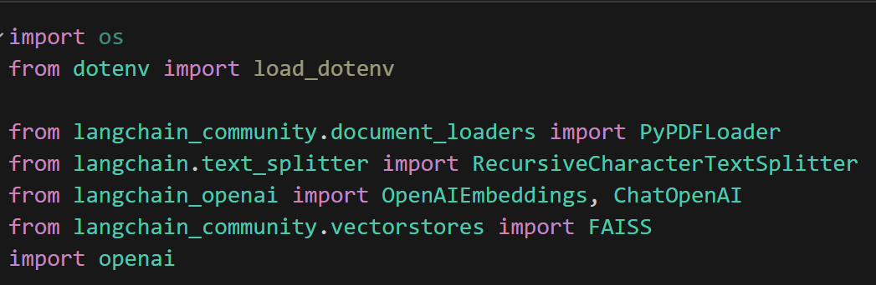
Step 1: Import Libraries

Slide 10
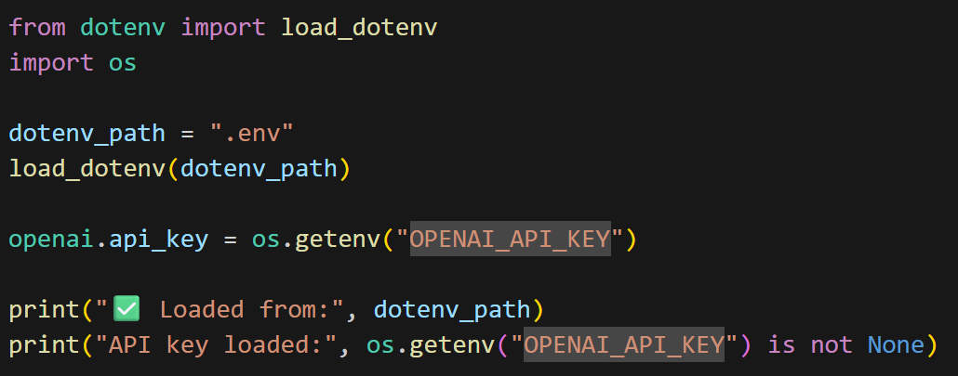
Step 2: Load Environment Variables

Slide 11
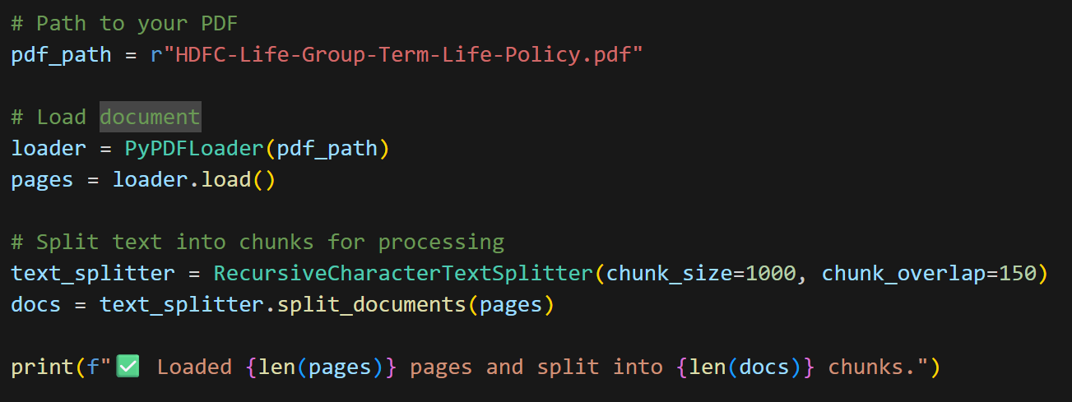
Load and Split PDF

Slide 12
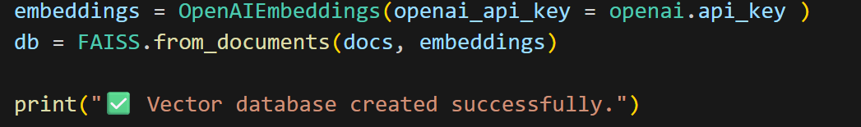
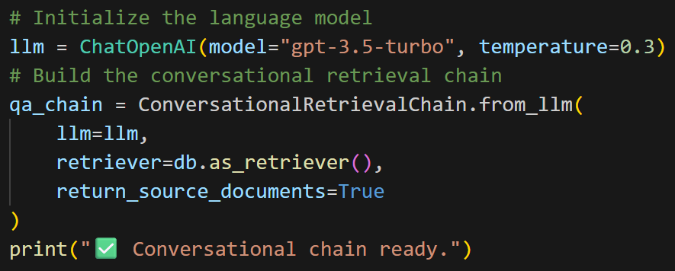
Create Embeddings and Vector Store

Slide 13
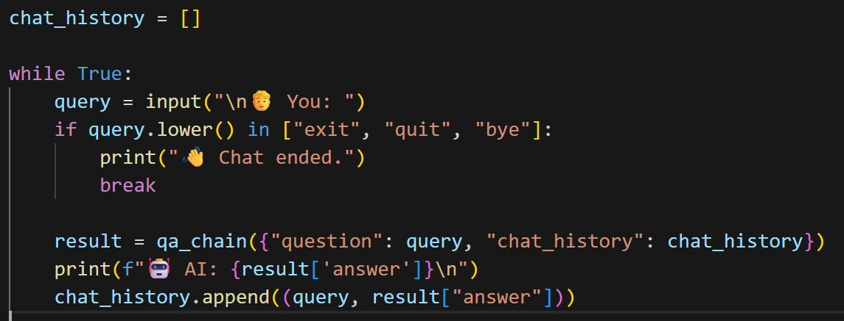
Start Chatting

Slide 14
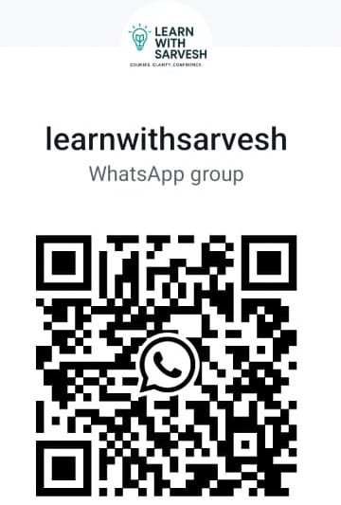

Socials – Li WhatsApp Insta

Slide 15

Ask anything - code, projects, tools, or roadmap!

